Slide 1
Sticks & Stones:
The Social Context for Learning
Self-Stigma Amongst the Obese
Emily Squyres
Dr. Emily Sandoz
Louisiana Contextual Science Research Group
Notes:
My name is Emily Squyres from the University of Louisiana at Lafayette. I am currently working on my master’s degree and am a proud member of the Louisiana Contextual Science Research Group, spearheaded by my advisor, mentor and friend, Dr. Emily Sandoz.
Today I want to talk about the social context for learning self-stigmatization among people struggling with obesity.

Slide 2
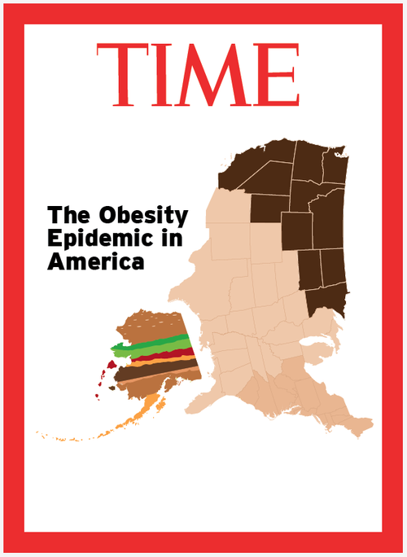
Notes:
It shouldn’t come as a surprise that the U.S. is battling a problem with obesity.
The U.S. has the second highest rates with ~32% of adults and 17% of kids being obese. (Mexico kicked us out of the top spot)
Since the 80’s these rates have doubled for adults and tripled for kids.
U.S. Center of Disease Control & Prevention estimates that by 2030 we could be facing 42% of the adult population being obese.
We frequently hear that obesity is affecting the physical health of the individual which also affects healthcare costs.
Rarely do we hear the discussion turning towards the individual’s quality of life.
But how can an individual have a high level of quality of life when they are stigmatized because of their body weight?

Slide 3
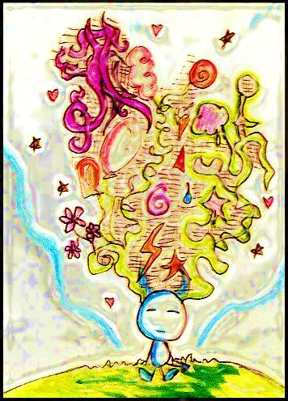
Notes:
I’d like to ask you to take a moment and imagine yourself heavier than you are now. Notice the weight of your body, your arms, your legs, feel gravity pushing down on you. Imagine your body slowing growing larger as your legs slide off of the edges of the chair, as your stomach pushes against the waistband of your pants. Imagine how heavy your arms and legs feel, how difficult it is to move around, how awkward you feel, how tired you are. Imagine that you’re much heavier than you were, walking is difficult and tiring, the pressure on your knees and ankles is tremendous.
Keeping all of that in mind, feeling so heavy and not being able to remember ever being any different,
Now imagine that you’re crossing the street when you hear “you’re fat” yelled out of the window of a passing car.
As if you didn’t know that already, with every step you take, every time you look in the mirror, every time you sit in a chair that is a little too snug everytime you start a diet and then fail….
But the yeller thinks that you didn’t hear him so he continues to yell “you’re fat” with increasing volume as you duck your head and try to walk faster despite how much your knees hurt.
Go ahead and open your eyes
I’d like for you to imagine if you really were that heavy, if in one year from now you looked in the mirror and realized that you’d gained twenty pounds, fifty, seventy-five, 100 pounds. What would you think about yourself? “I am ____”. Did you think that you were ugly, gross, disgusting, weak, stupid, lazy? Those are the more common stereotypes held about obesity. Did anyone think “that wouldn’t happen to me”? If so, ask yourself why it wouldn’t happen to you. The odds are that the answer involves a negative stereotype

Slide 4
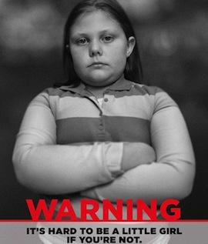
Notes:
Stigma & Obesity
A stigmatized person is perceived to be different from the norms due to an undesirable characteristic which leads to a devaluation in certain social contexts.
Some of these contexts are work, school, movie theater, airport, airplane, anywhere that an obese person can go and the most popular place is at….
Home (Yep, I said home)
Puhl & Brownell (2006) found that, as rated by obese participants, the most severe sources of stigma are family and friends.
Cramer & Steinwert (1998) found that kids as young as three years old subscribe to the cultural stigma of obesity.
Healthcare professionals (doctors, nurses, dieticians, psychiatrists, psychologists, therapists)
In 2003 Schwartz, Chambliss, Brownell, Blair & Billington administered the Implicit Attitude Test to a group of researchers who were attending the annual meeting of the North American Association for the Study of Obesity.
Results: Significant anti-fat bias seen on explicit and implicit measures
How is this possible? These are people who work day in and day out with folks suffering from obesity.
It’s most likely explained by characteristics that are thought of as being within the individual’s control are more likely to be vilified.
Obesity is most commonly thought of as an imbalance between energy intake and energy output and hence thought of as controllable.
Protestant ethic is an ideology that incorporates the ideas that success is due to hard work. Therefore, a lack of success is caused by immoral weaknesses like a lack of self-discipline (Quinn & Crocker, 1999).
Allison, Basile & Yuker (1991) found that people view obese people more positively when they believe that the obese do not have any control over their weight.

Slide 5
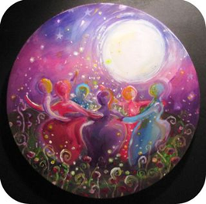
Notes:
Social Identity Theory
So, now that we’ve discussed sources of stigma, we can begin to talk about how it affects the obese individual.
Social Identity Theory says that people tend to identify themselves as members of a group.
Group members tend to show an in group bias towards fellow group members and an outgroup bias against other groups.
Almost all groups exhibit this behavior except for obese people .
Obese people tend to exhibit an outgroup bias towards thin people and against other overweight or obese people.
Couple of different theories about this finding:
Obese individuals don’t categorize themselves as being “that fat” so they can’t be a member of that group.
Over identification: She is supposed to be disgusting for being fat so I must be disgusting too, hence we’re all disgusting and should not be looked upon nicely.
When we were about a year old we learned “I” and by extension “you”. Social identity theory speaks to how we begin to distinguish “us” from “them”.
LEAD INTO RFT→

Slide 6
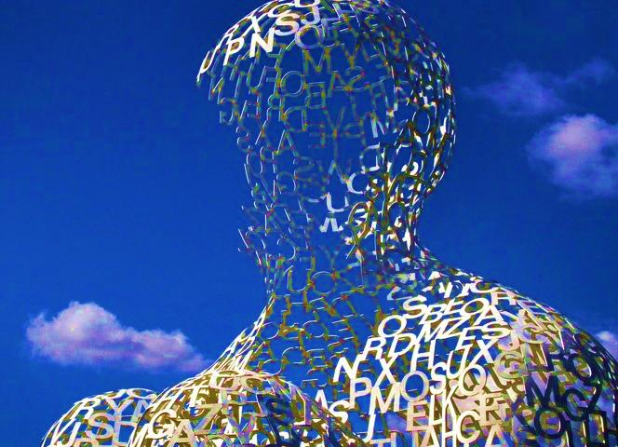
Notes:
RFT & Social Categorization
From an RFT perspective, categorizing is really just creating equivalence classes that are equal to one another.
Ex: Looking around this room to scope out whose come to our symposium and grouping: student, researcher, clinician, bored spouse…. that classification impacts your behaviors by taking on different functions.
And remember that behaviors are not just things that you can see but are also thoughts,
Afterwards, if any of you came up to ask me questions I might react a bit differently depending on what category I put you in.
If you’re a student I might say “wow, I was so nervous up there!”
If you’re someone who I referenced in my thesis I’m more likely to stumble over my words while thanking you for coming (“us” versus “them”)
This is like building a hierarchy of equivalence classes.
RFT is really about how language allows us to form classes of anything (equivalence classes)
Social Categorization tells us what people do but RFT adds the learning history of the individual when forming these classes, thereby relating events in our world.

Slide 7
Diectic Relational Responding
ME
MOM
THERE
HERE
NOW
THEN
Notes:
DIECTIC RELATIONAL RESPONDING:
RFT posits that we learn to discriminate “self”.
Developmentally, we learn diectic relational responding very early.
Gain a sense of self: I am not Mom or my teddy bear, and this is created verbally.
Sense of self becomes impacted verbally: “I am sad” quickly becomes “I am a sad person”
We also begin to discriminate “here” from “there” (keeping in mind that there is an aspect of the self embedded in “here”)
Same thing with “now” and “then”

Slide 8
STUPID
Beautiful
UGLY
Smart
THIN
FAT
OPPOSITE
ME
JILL
LIZ
GINA
DANI
ASH
Notes:
RFT & Obesity Self-Stigma
Self-Stigma
There is a possibility of self-stigma whenever “I” belongs to the hierarchy.
Keep in mind that this hierarchy has been established based on the individual’s learning history.
And it doesn’t have to be direct contact.
Using myself as an example, At some point I may have been told that I was “fat” BUT I also may have saw/heard someone that I felt similar to in body shape be referred to as fat. “well, if she’s fat and we’re so similar in body size then I must be fat” The opposite of fat is thin so now “fat” and “thin” become categories to use when out in the world.
Ex: Gina is thin and people say that she is beautiful. I know that I am fat so I must be the opposite of beautiful since fat is the opposite of thin= I am ugly. This is how RFT explains self-stigma.
Avoidance with the functions of “fat” serves to maintain self-stigma and membership in that category .

Slide 9
Notes:
Problems with self-stigmatization
There’s such an abundance of adversives that are related to “fat” that there can be a great deal of rigidity around the category.
Also may see an investment of the self concept in the category. You may see this in people who seem “stuck”.
Ex: I’m not just a person who is obese and this host of other things. My self concept becomes “I am fat” and that is it. I can’t go back to school because I am fat, I can’t find a better job because I am fat, I can’t fall in love……
This can lead to a limitation of available behaviors in the repertoire -> NOT HEALTHY!
Even once the individual begins to show more flexibility that rigidity is still present.
Going back to the example of “I can’t go back to school because I am fat”→ I can’t get up and present in front of the class because I’m fat and everyone will be looking at me. Individual does that. Now it’s I can’t go to a conference and present because I am fat. Individual does that . Now it’s I can’t discuss my thesis work in a presentation at a conference because my work is about obesity and I am obese......Well, I think I’ve done that!
Also leads to avoidance with the functions of “fat” which serves to maintain self-stigma and membership in that category. Things like:
Eating when stressed out
Not engaging in perspective taking with “thin” friends→ limitations of experiences with the self & bodies.

Slide 10
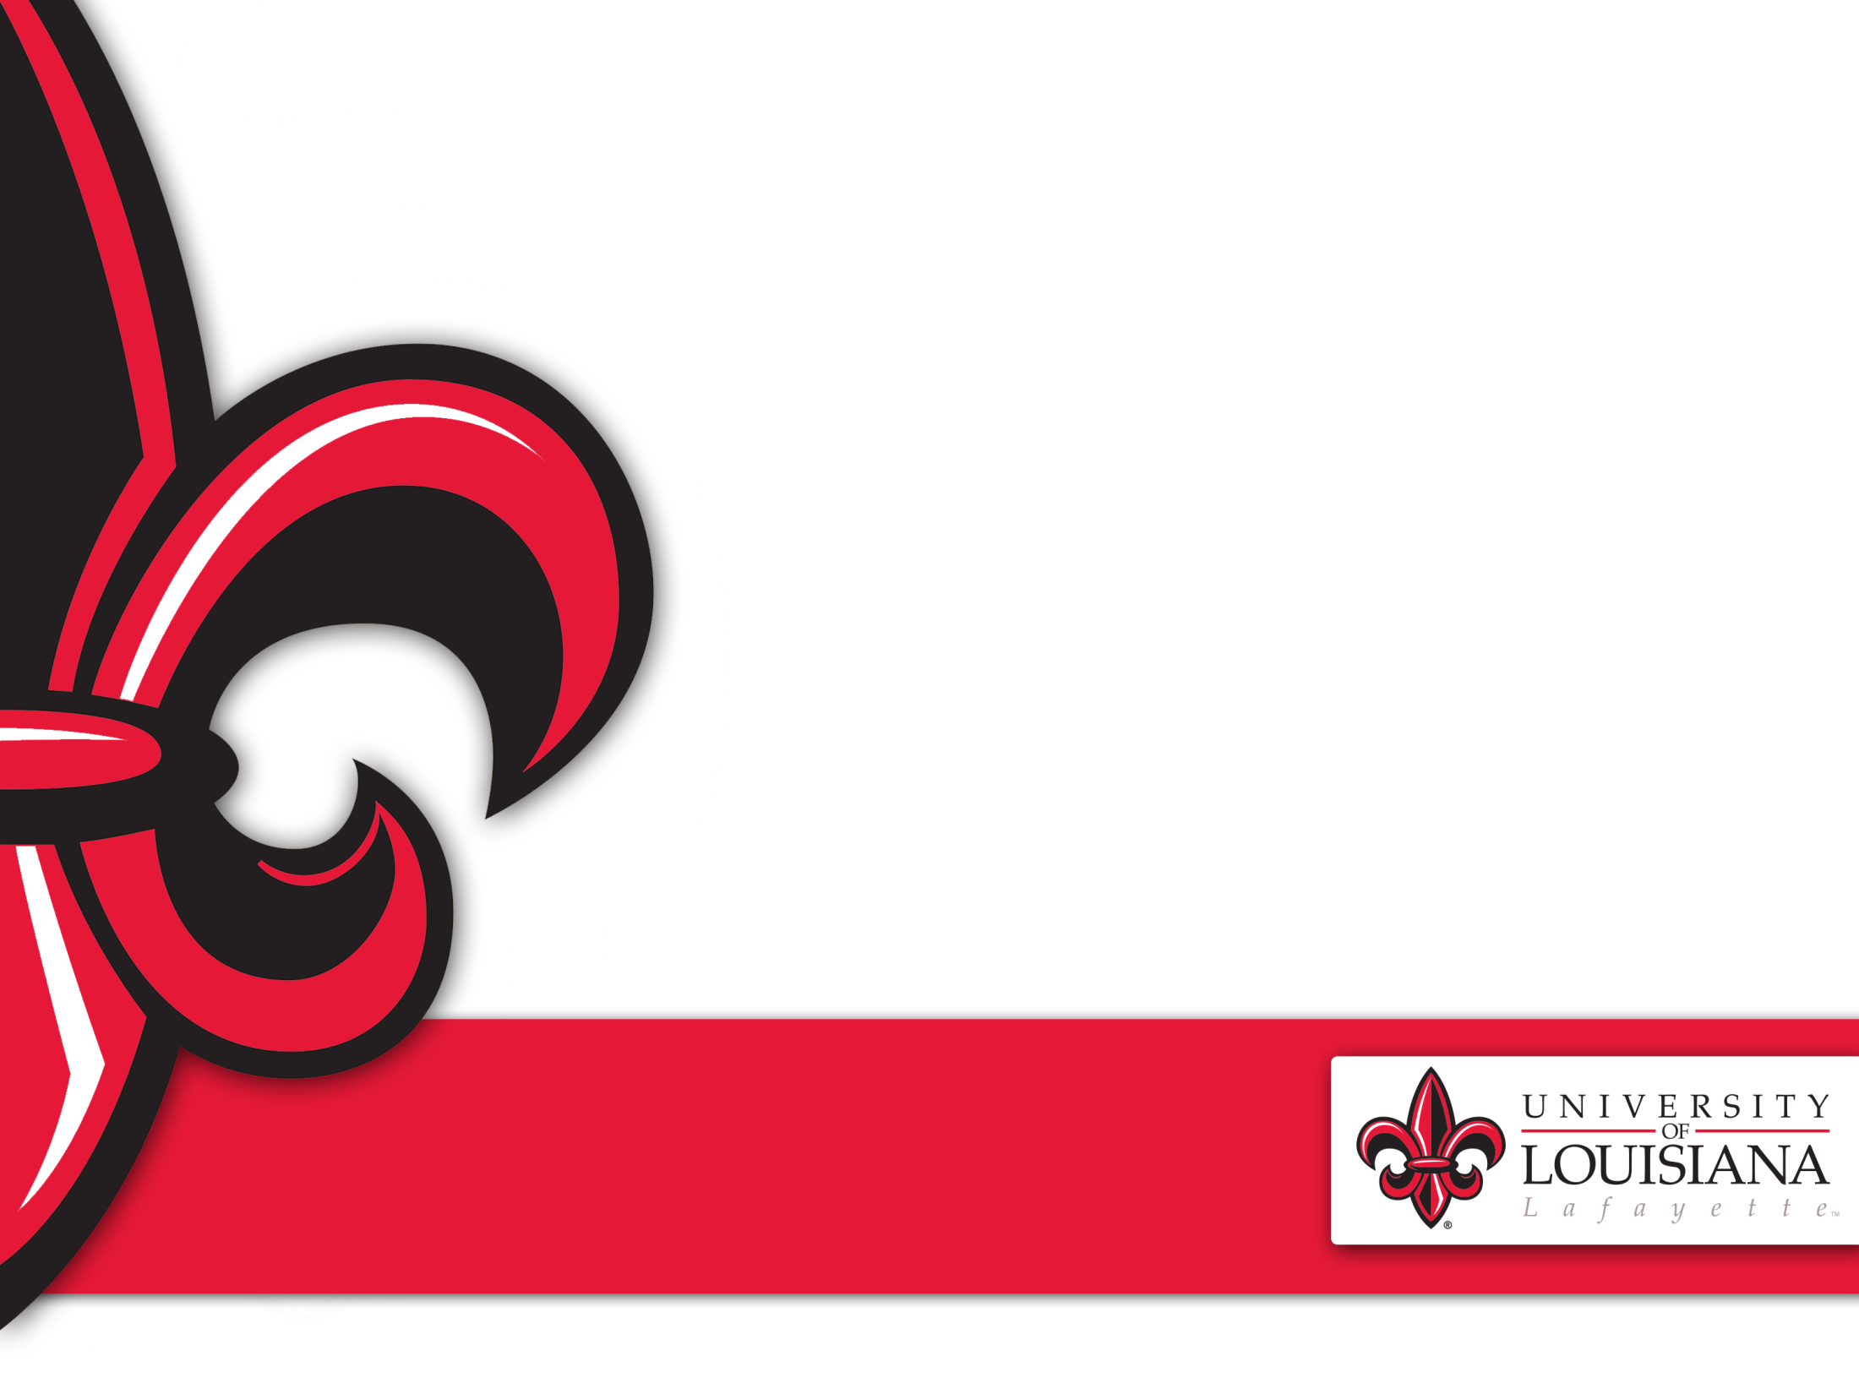
Emily Squyres
emmerss@gmail.com
Emily K. Sandoz
emilysandoz@louisiana.edu
www.louisianacontextualscience.com
Notes:
.

